Slide 1
Initial musical task
Listen carefully to the following piece of music
Reflect to yourself, what do you hear? How many instruments can you hear?
https://www.musical-u.com/learn/making-sense-of-polyrhythms/

Slide 2
Descriptive Music and Polyrhythms
Learning Objectives
1. To define what a polyrhythm is and create a polyrhythm
2. To compose and perform a piece of descriptive music that uses polyrhythms and tells a story

Slide 3
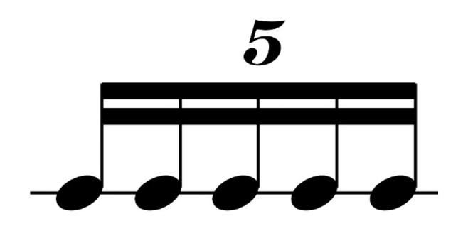
Introduction to polyrhythms - 5 minutes
What is a polyrhythm?
A polyrhythm is when two or more rhythms with different pulses are heard together at the same time. It is a contrasting division of the beat that can sound exciting and complex.
You will now hear some examples of polyrhythms that use contrasting rhythms. What rhythms can you hear?
Let’s create create some different polyrhythms. Clap or tap using body percussion these rhythms as we go through them.
Duplet’s (2’s)
Triplet’s (3’s)
Quadruplets (4’s)
Quintuplet (5’s)
Li - on
El - e - phant
Al - i - ga - tor
🐘
Hip - po - po - to - mus
🦁
🐊
🦛

Slide 4
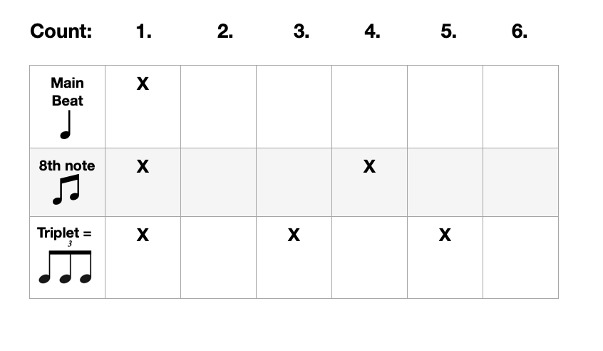
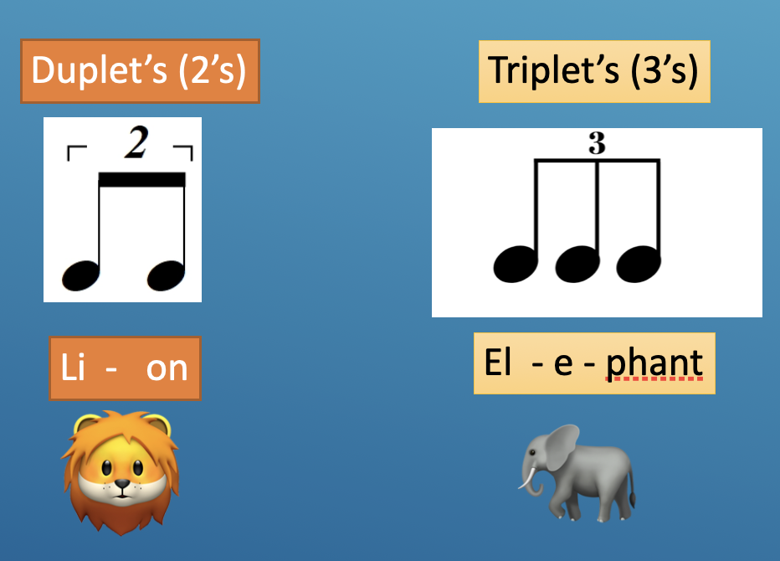
Exploration of 2:3 Polyrhythms
Mnemonic for 2:3 polyrhythm
Nice - Cup - Of - Tea
Both - Right - Left -Right
Stomp
Duplet =
Both
Left
Both
Right
Right
You can find any polyrhythm mathematically by finding the lowest common multiple. In this case for ‘2’ and ‘3’ that number is 6. So we have six beats.
Polyrhythms can be complicated for one person to perform (but not impossible). Sharing the contrasting rhythms out with other musicians can help make it easier. Let’s work together as a whole group to perform this 2:3 polyrhythm.

Slide 5
Descriptive Music and Polyrhythms
Learning Objective 1 - Self Assessment
Thumbs up for objective met fully - half way for partially met - down for not yet met
1. To define what a polyrhythm is and create a polyrhythm
2. To compose and perform a piece of descriptive music that uses polyrhythms and tells a story
✅

Slide 6
Applying polyrhythms to descriptive music - 10 minutes
Recap: Descriptive music describes a story, a person or sets a scene. Music that uses polyrhythms like African music also tells a story. Polyrhythms are used across lots of genres including, pop, rock, classical, jazz and world music.
Creative Task:
In groups, create a short piece of descriptive music that makes use of polyrhythms and tells a simple story i.e. a journey through the jungle, or walking through a cave.
Aim for your music to include:
Polyrhythms - e.g. the 3:2 ’Hot Cup of Tea’
On the keyboard (individually or in pairs):
Left hand bass note on A
Right hand improvise polyrhythms using A minor notes (all the white keys).
Add chords if you wish

Slide 7
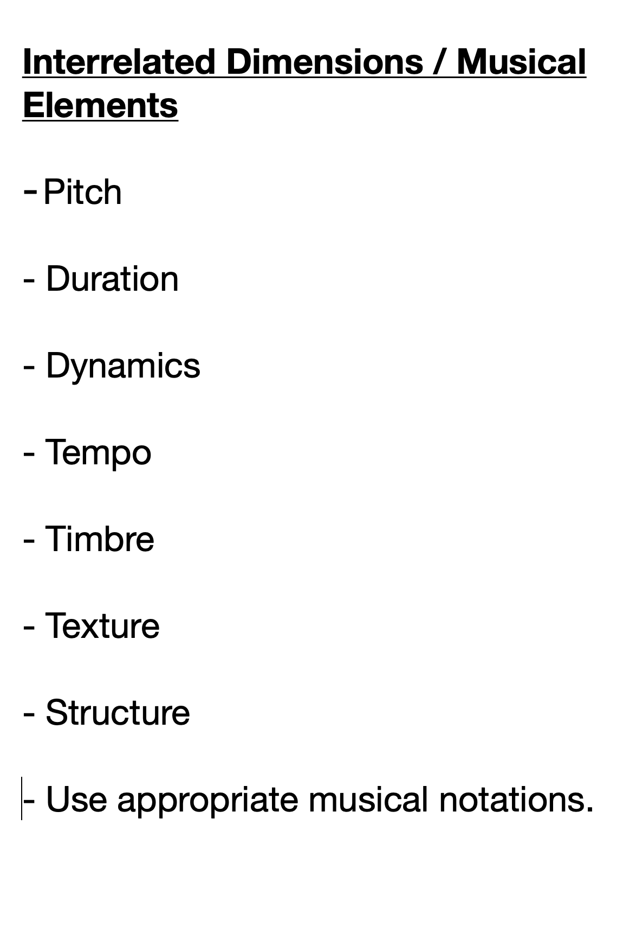
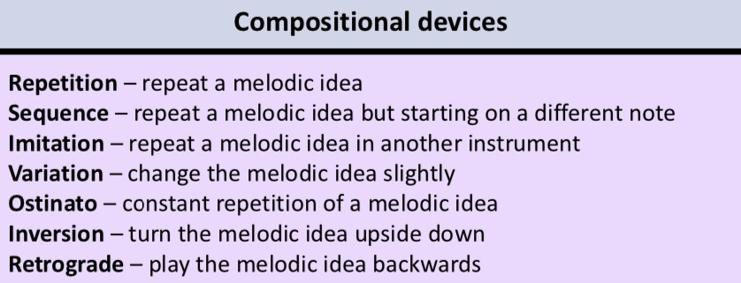
Success criteria for composition and performance
Desirable targets:
Use two different contrasting rhythms at the same time (this is a polyrhythm)
Share the parts of different contrasting rhythms
Improvise or compose a melody in A minor
Improvise or compose a bass riff or ostinato ( a repeating pattern) around the note A
Follow the 3:2 rhythm grid together with percussion and share the parts out
Aspirational targets:
6. To use different chords from A minor
7. Inspire others in the group with creative musical ideas
8. To improvise a melody that uses different rhythms (i.e. duplets, triplets, quadruplets quintuplets),
9. To play a polyrhythm on more than one instrument (i.e. on a djembe, hand drum and keyboard)
10. As an individual be able to perform two separate rhythms at the same time like the 3:2 polyrhythms
11. Master the ‘nice cup of tea’ 3:2 polyrhythm and perform with confidence and flair

Slide 8
Composition Resources
A minor scale
For improvising and composing melodies
2:3 Polyrhythm
‘Nice Cup of Tea’ or ‘not difficult’
Stomp
Duplet =
Both
Left
Both
Right
Right

Slide 9
Performances and Feedback
Success Criteria for composition and performance
Desirable targets:
Use two different contrasting rhythms at the same time (this is a polyrhythm)
Share the parts of different contrasting rhythms
Improvise or compose a melody in A minor
Improvise or compose a bass riff or ostinato ( a repeating pattern) around the note A
Follow the 3:2 rhythm grid together with percussion and share the parts out
Aspirational targets:
6. To use different chords from A minor
7. Inspire others in the group with creative musical ideas
8. To improvise a melody that uses different rhythms (i.e. duplets, triplets, quadruplets quintuplets),
9. To play a polyrhythm on more than one instrument (i.e. on a djembe, hand drum and keyboard)
10. As an individual be able to perform two separate rhythms at the same time like the 3:2 polyrhythms
11. Master the ‘nice cup of tea’ 3:2 polyrhythm and perform with confidence and flair
Homework: Reflect upon what are your own musical aims and goals going forward from here?

